Slide 1
References
Donald A Neamen, Electronic Circuits-Analysis and Design Text book
Sedra and Smith, Microelectronics Text book (some portion).
Raza Vi, Fundamentals of Microelectronics, Reference book
Milliman and Halikas, Microelectronics, Reference book

Slide 2
BJT: Bipolar Junction Transistor
Discuss the physical structure and operation of the bipolar junction transistor.
Understand the dc analysis and design techniques of bipolar transistor circuits.
Investigate various dc biasing schemes of bipolar transistor circuits, including integrated circuit biasing.

Slide 3
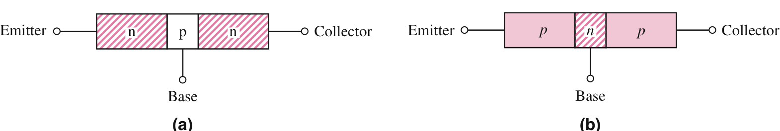
Base is very narrow
Emitter ~ 10¹⁹ /cm³
Base ~ 10¹⁷ /cm³
Collector ~ 10¹⁵ /cm³
Electrically unsymmetrical
Four biasing conditions
Depending on forward or reverse bias

Slide 4
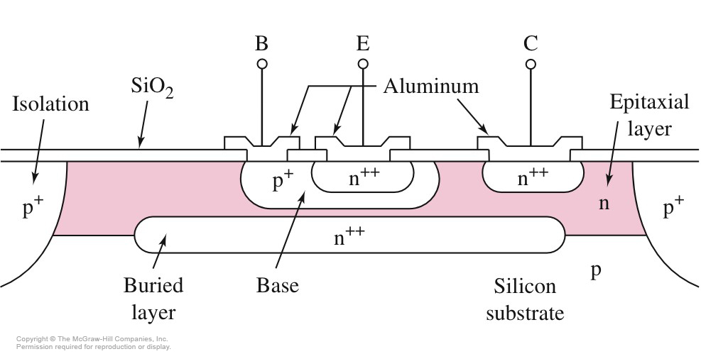
Cross Section of Integrated Circuit npn Transistor
Complex structure

Slide 5
Modes of Operation
Forward-Active
B-E junction is forward biased
B-C junction is reverse biased
Saturation
B-E and B-C junctions are forward biased
Cut-Off
B-E and B-C junctions are reverse biased
Inverse-Active (or Reverse-Active)
B-E junction is reverse biased
B-C junction is forward biased

Slide 6
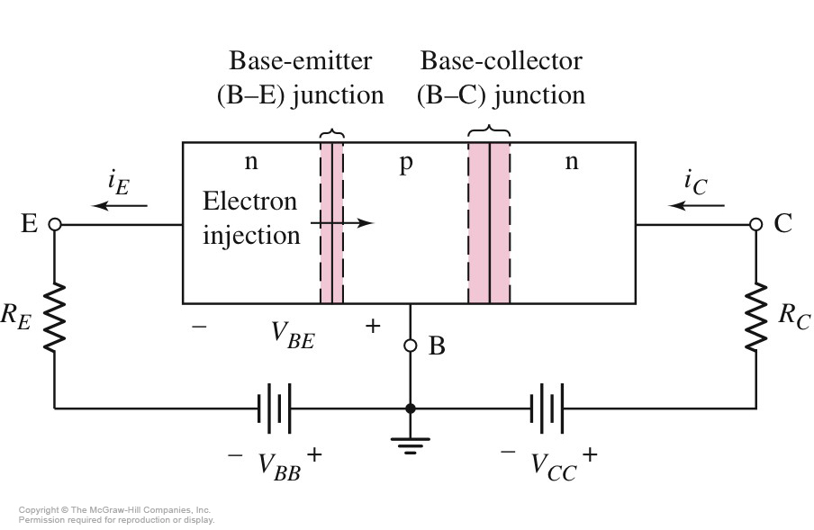
npn BJT in Forward-Active

Slide 7
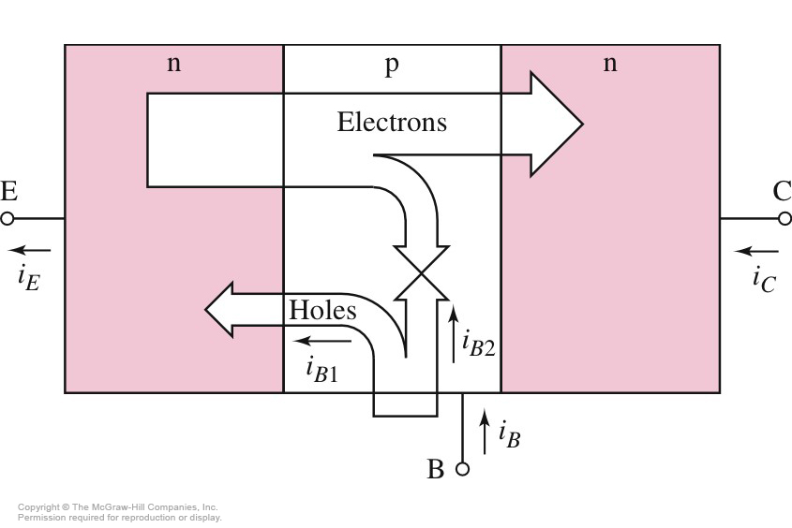
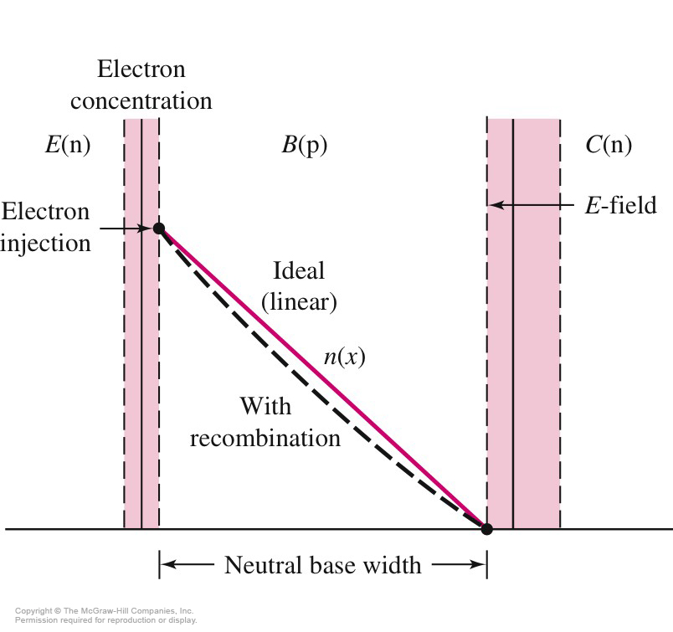
Understanding the current flow in npn transistor
Emitter current
Depends on cross-section (10⁻¹² -10⁻¹⁵ A)
Due to large concentration gradient, electrons injected from emitter diffuse across the base in to B-C space region where EF sweeps them into collector, forming collector current which depends on the B-E voltage
Collector current

Slide 8
i_{c} <i_{E} ; i_{c} = α i_{E} , where α is called as common base current gain and is less than unity.
Base Current:
Two components
Flow of holes
Recombination with majority carriers (recombination current)

Slide 9
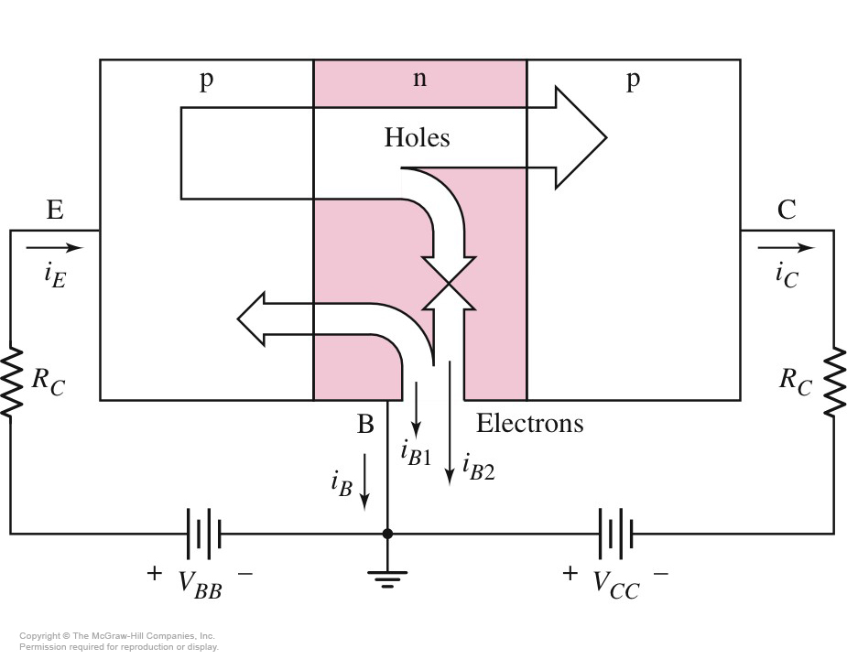
Electrons and Holes in pnp BJT

Slide 10
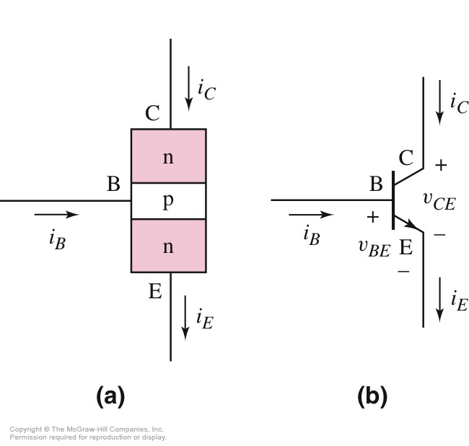
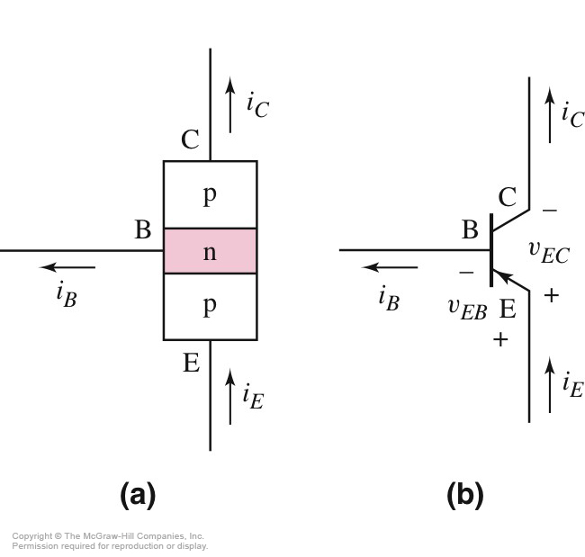
npn
pnp

Slide 11
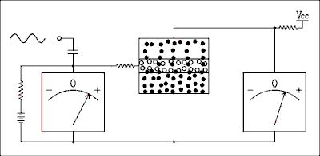
Collector
Base
Emitter
Movement of electrons and holes in npn transistor

Slide 12
Circuit Symbols and Current Conventions

Slide 13
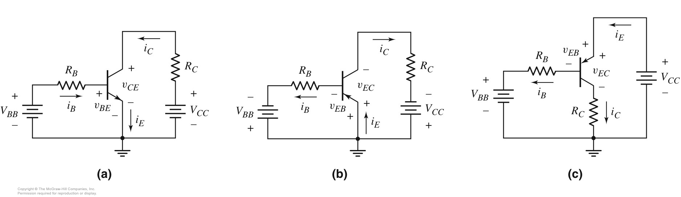
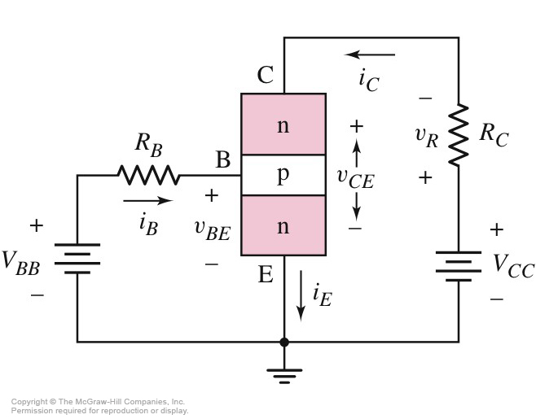
Common emitter current gain
Defined as ratio of collector and base current
Key parameter
Assumed as constant for any given transistor
50<β<300
Highly dependent on fabrication

Slide 14
Current Relationships

Slide 15
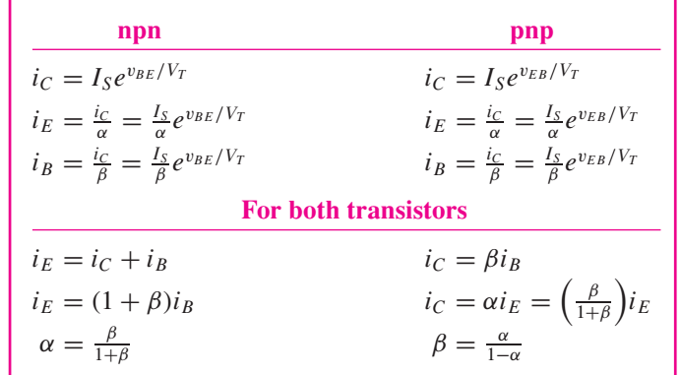
Common-Emitter Configurations
True for active region only

Slide 16
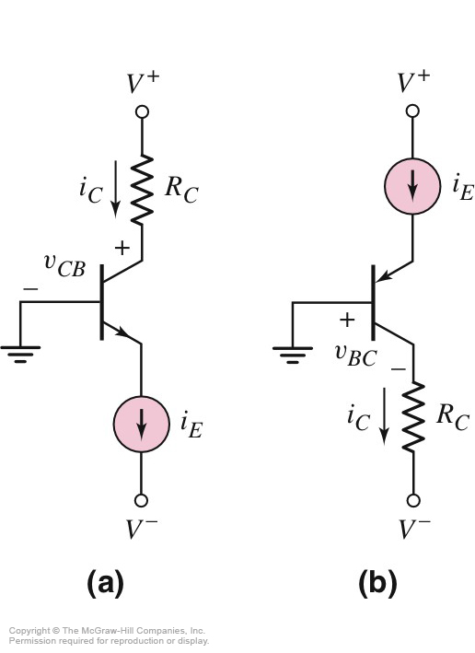
Common-Base Configuration
Current source provide emitter current

Slide 17
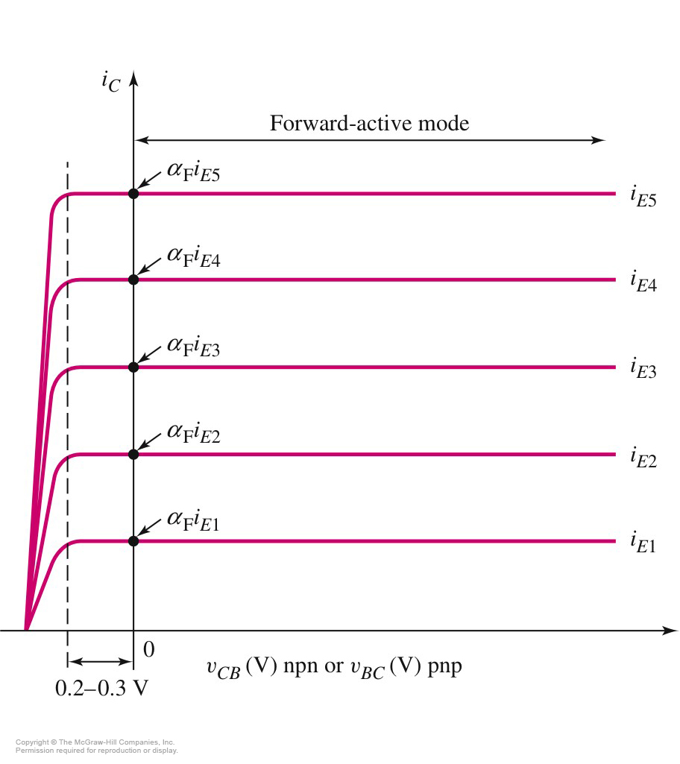
Current-Voltage Characteristics of a Common-Base Circuit
B-C/C-B junction forward biased, transistor no longer in forward active mode
B-C/C-B, reverse biased, i_{c} ~ i_{E}
common-base: ideal constant current-source

Slide 18
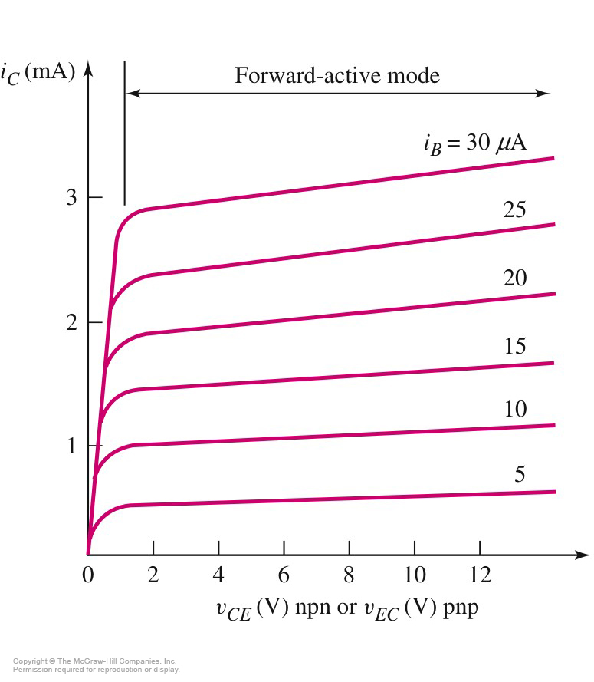
Current-Voltage Characteristics of a Common-Emitter Circuit
V_{CE} ≥ V_{BE} (on)
Finite slope to the curves
-due to base-width modulation
- observed by J.M. Early
- called as Early effect

Slide 19
Common-base
Common-emitter

Slide 20
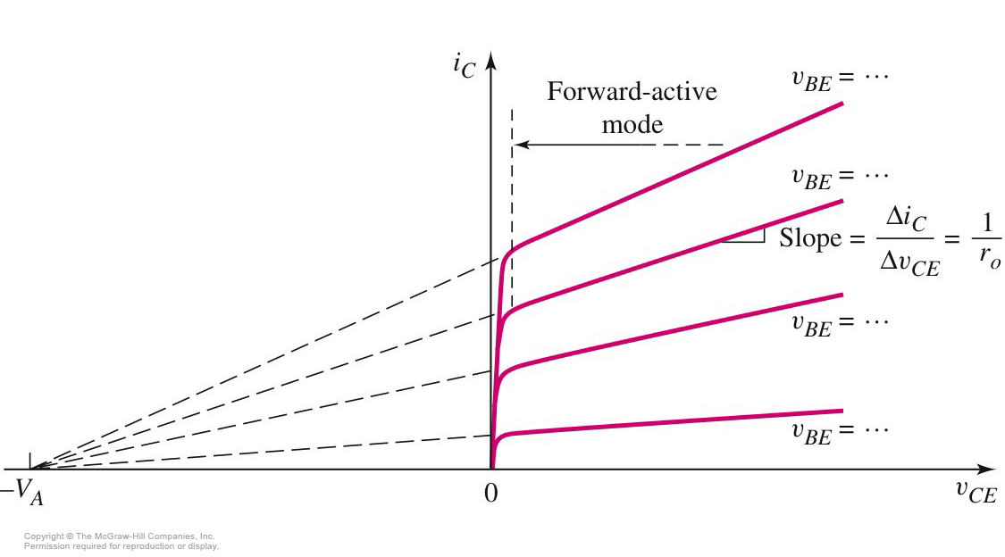
Early Voltage/Finite Output Resistance

Slide 21
DC analysis of transistor circuits
Use of piecewise linear model of pn junction
Assume transistor in forward active mode
Common emitter configuration
V_{CE}>V_{BE} (on)

Slide 22
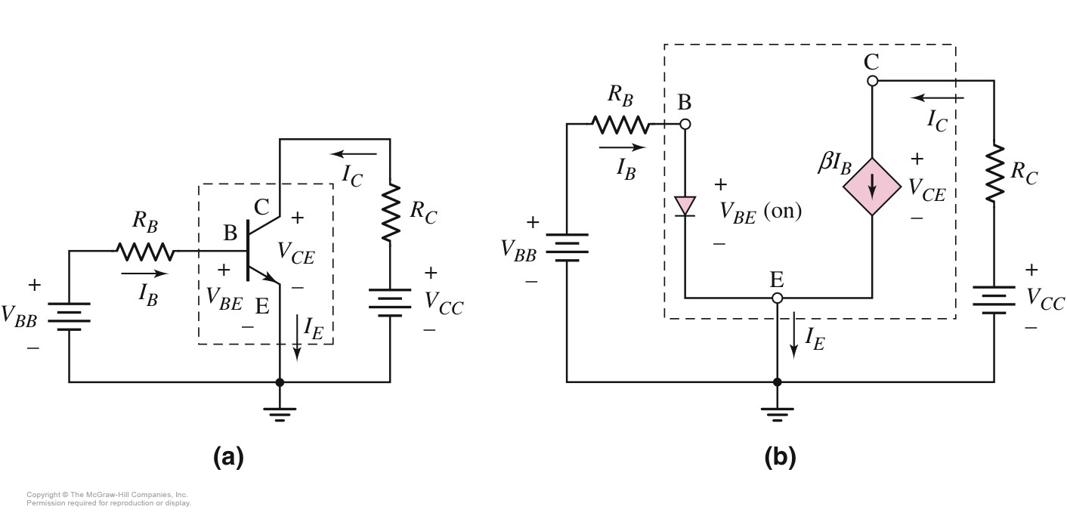
DC Equivalent Circuit for npn Common Emitter

Slide 23
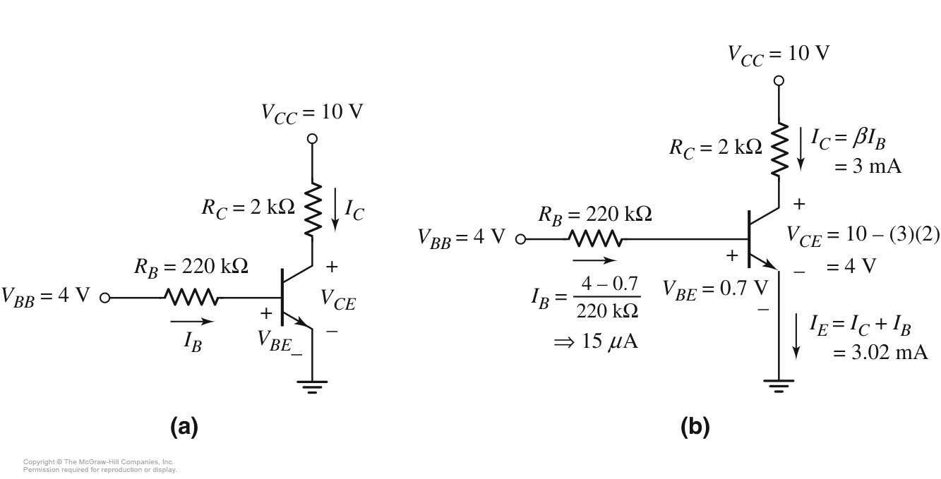
Example 1.

Slide 24
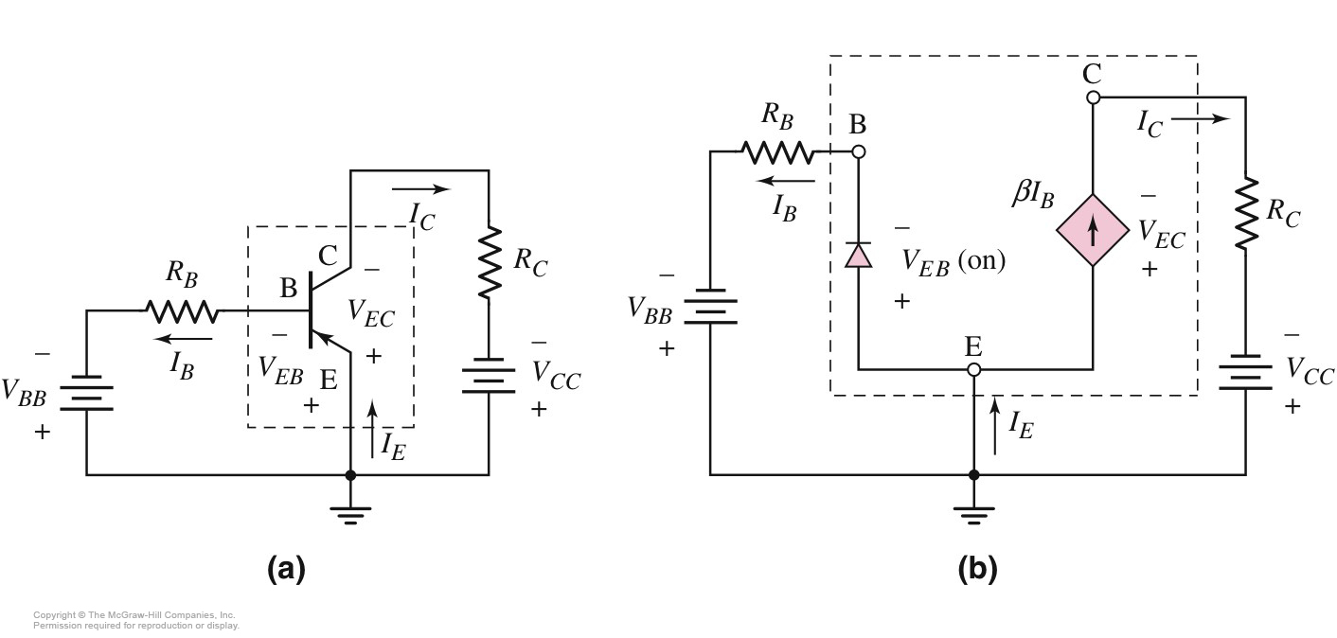
DC Equivalent Circuit for pnp Common Emitter

Slide 25
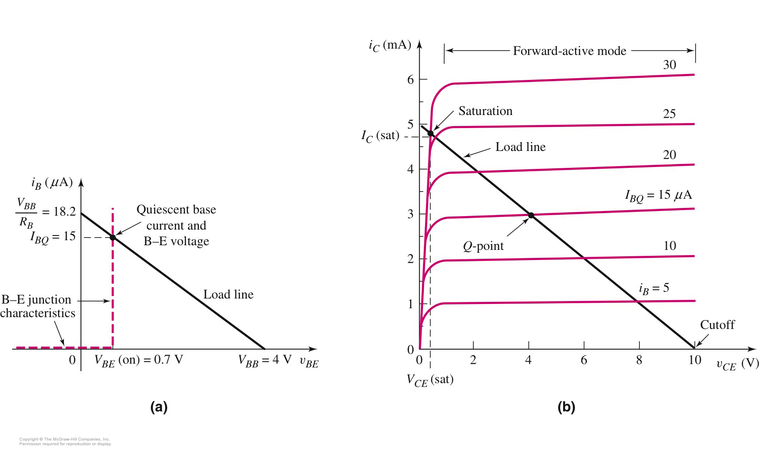
Load Line
Helps to visualize the characteristics of a transistor circuit

Slide 26
Saturation mode
V_{BB} I_{B} Q-point
As base current continue to increase, a point is reached where the collector current I_{C} can no longer increase.
- Transistor is biased in saturation mode
I_{C}/I_{B} < β

Slide 27
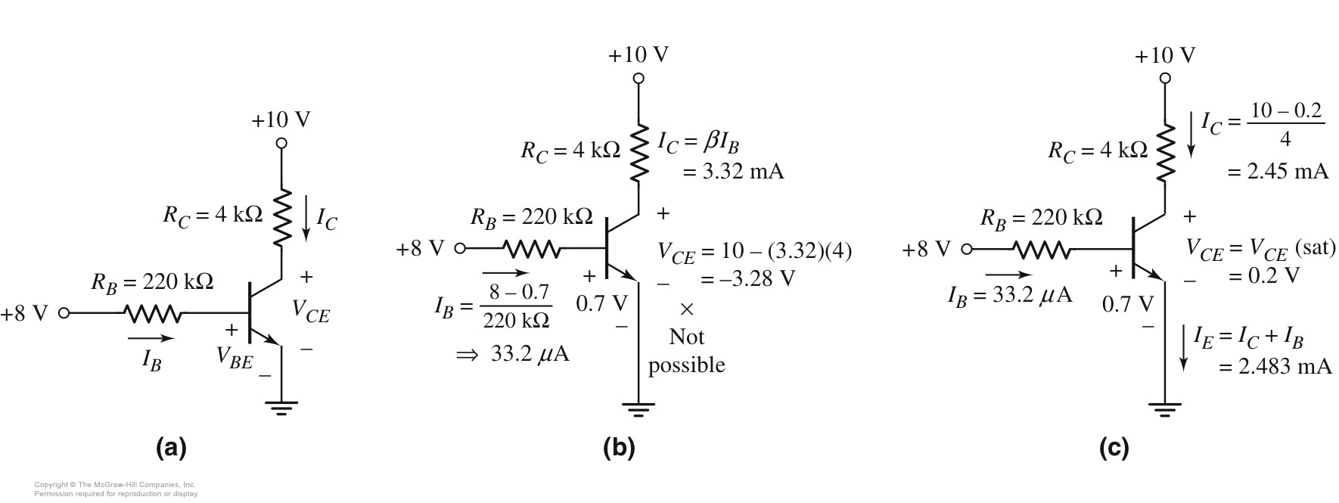
Example 2:
circuit
Circuit showing values with an assumption of forward active mode
Circuit showing values with an assumption of saturation mode

Slide 28
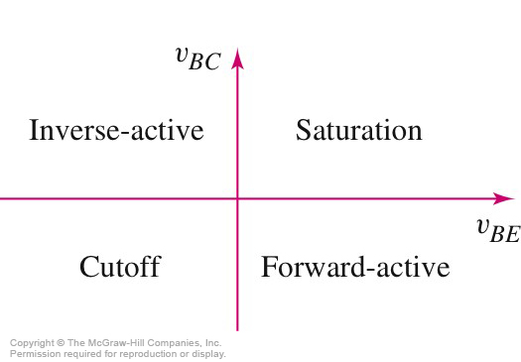

Slide 29
Problem-Solving Technique: Bipolar DC Analysis
Assume that the transistor is biased in forward active mode
V_{BE} = V_{BE}(on), I_{B} > 0, & I_{C} = βI_{B}
Analyze ‘linear’ circuit.
Evaluate the resulting state of transistor.
If V_{CE} > V_{CE}(sat), assumption is correct
If I_{B} < 0, transistor likely in cutoff
If V_{CE} < 0, transistor likely in saturation
If initial assumption is incorrect, make new assumption and return to Step 2.

Slide 30
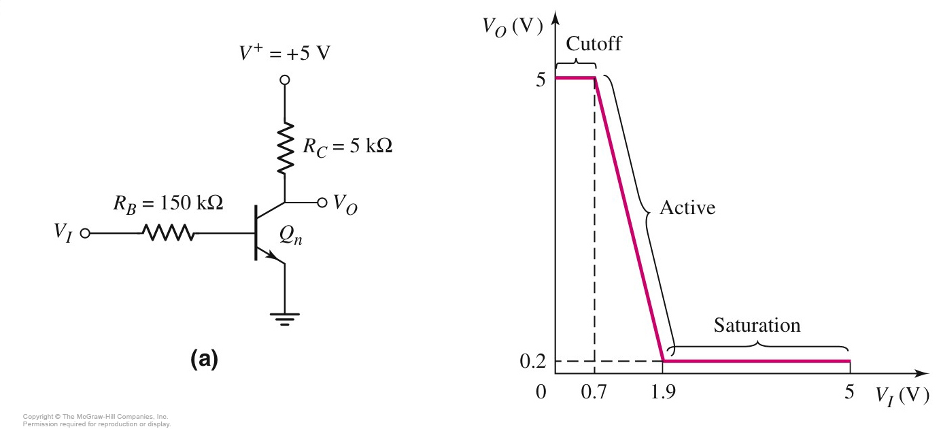
Voltage Transfer Characteristic for npn Circuit

Slide 31
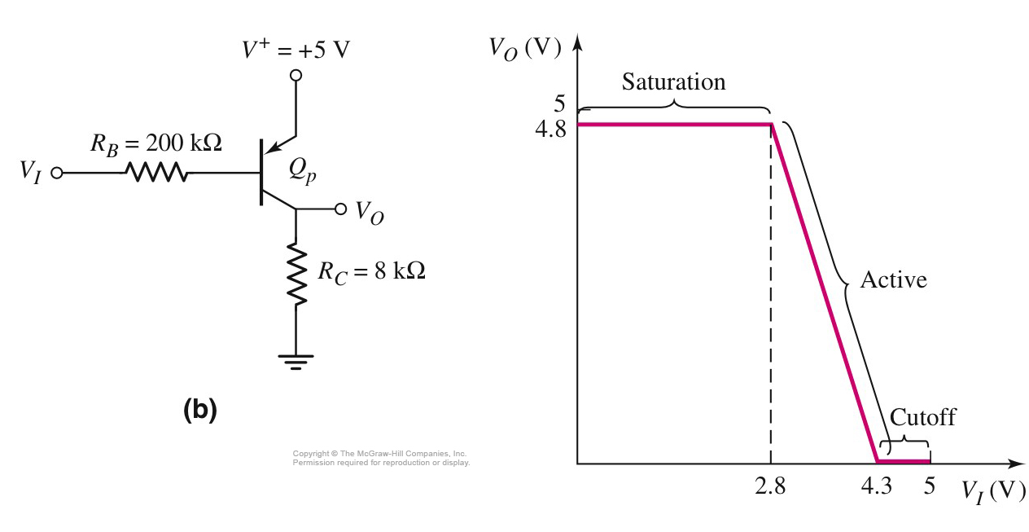
Voltage Transfer Characteristic for pnp Circuit

Slide 32
BJT Biasing
Single base resistor biasing
Voltage divider biasing
Biasing stability

Slide 33
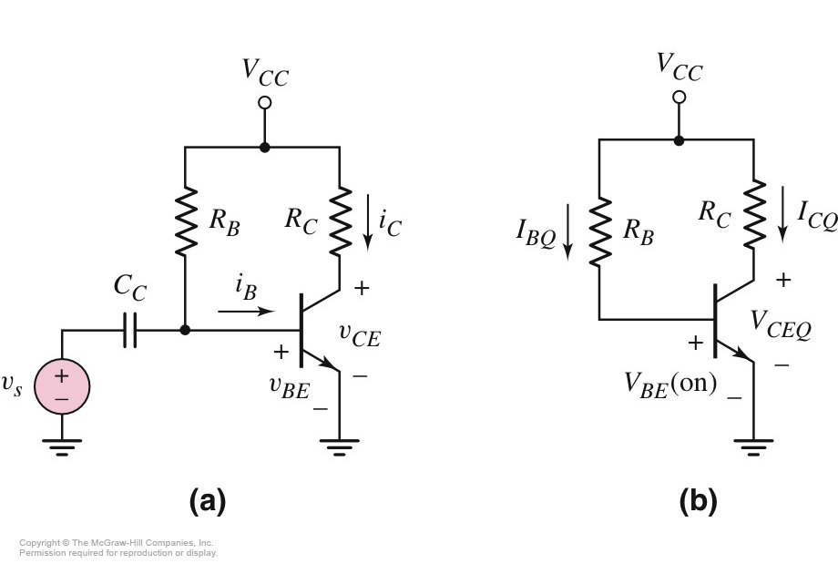
Single Base Resistor Biasing

Slide 34
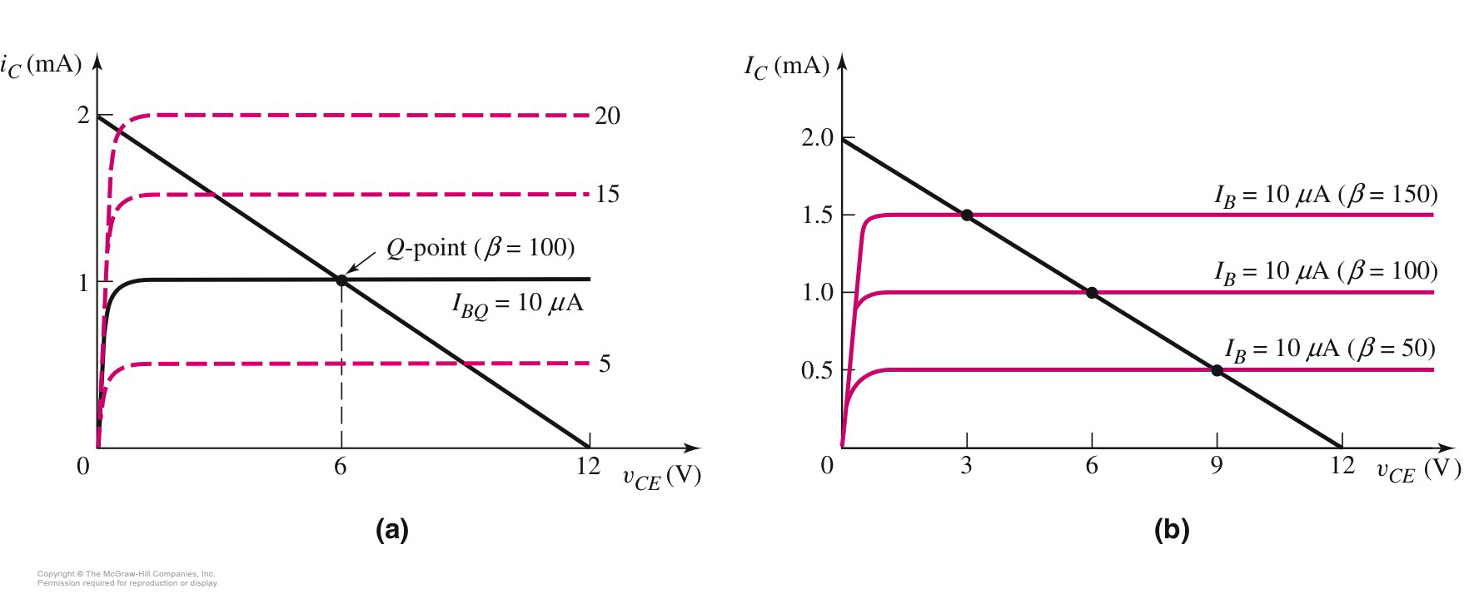

Slide 35
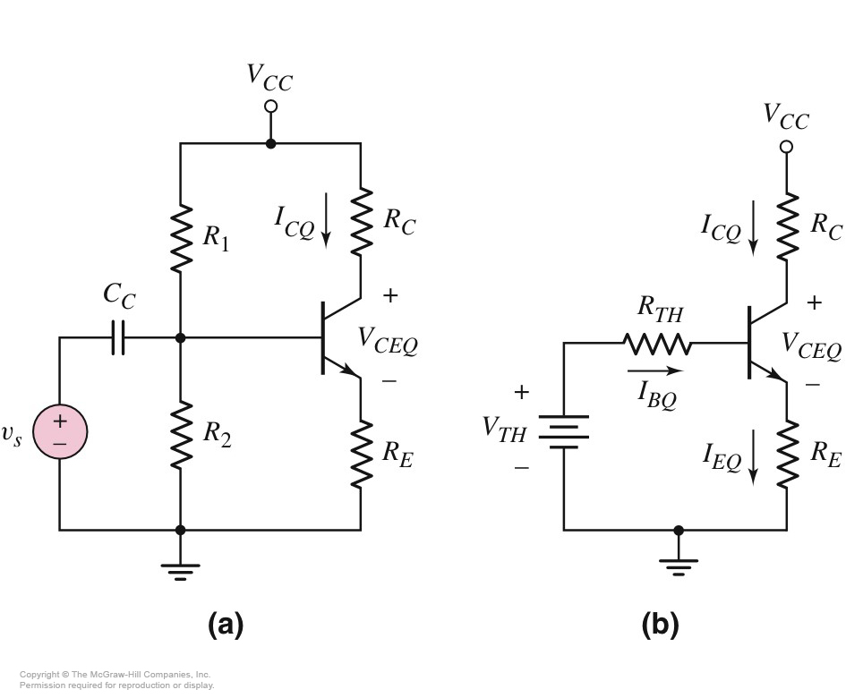
Common Emitter with Voltage Divider Biasing and Emitter Resistor
R_{B} is replaced by R₁ and R₂.
Emitter resistor is added. AC signal is coupled through C_{c}.
Analyzed by Thevenin equivalent circuit for the base circuit.
(1)

Slide 36
Use of KVL in B-E loop
(2)
If the transistor is biased in forward-active mode
(3)
From (2), the base current can be calculated. Hence, the collector current can be found
The design requirement for bias stability is
The collector current is therefore,

Slide 37
β >> 1, β/(1+β) ~ 1

Slide 38
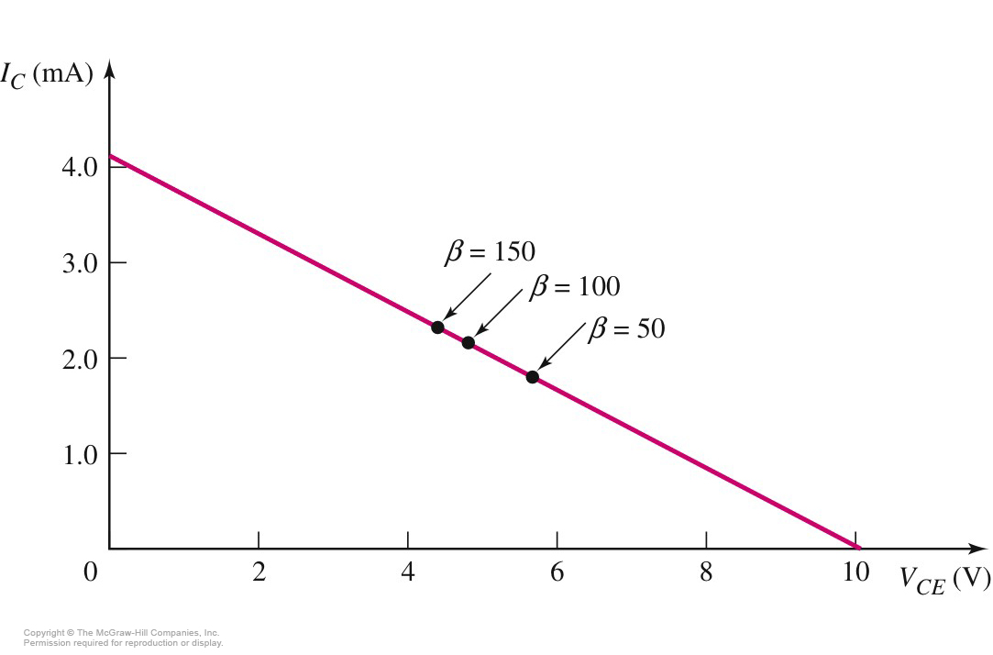
Example:

Slide 39
BJT Amplifier
Two types analysis
DC analysis
Applied DC voltage source
AC analysis
Time varying signal source
Superposition principle (linear amplifier)
The response of a linear amplifier circuit excited by multiple independent input signals is the sum of the responses of the circuit to each of the input signals alone.

Slide 40
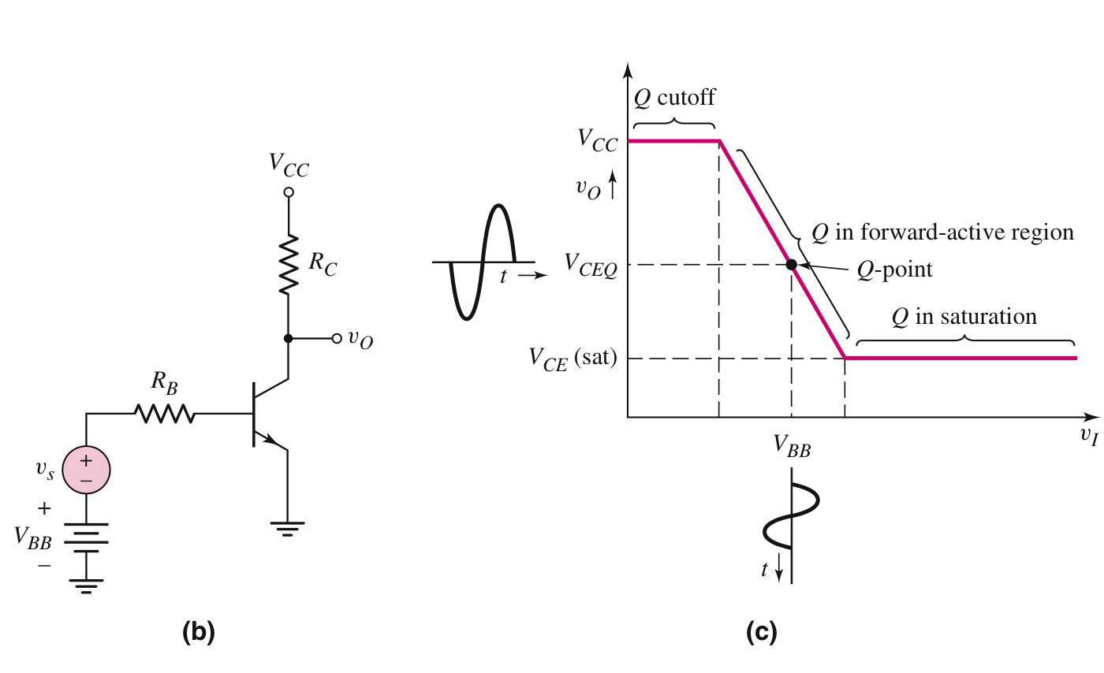
Bipolar linear amplifier
Variable | Meaning
i_{B}, v_{BE} | Total instantaneous values
I_{B}, V_{BE} | DC values
i_{b},v_{be} | Instantaneous ac values
I_{b}, V_{be} | Phasor values

Slide 41
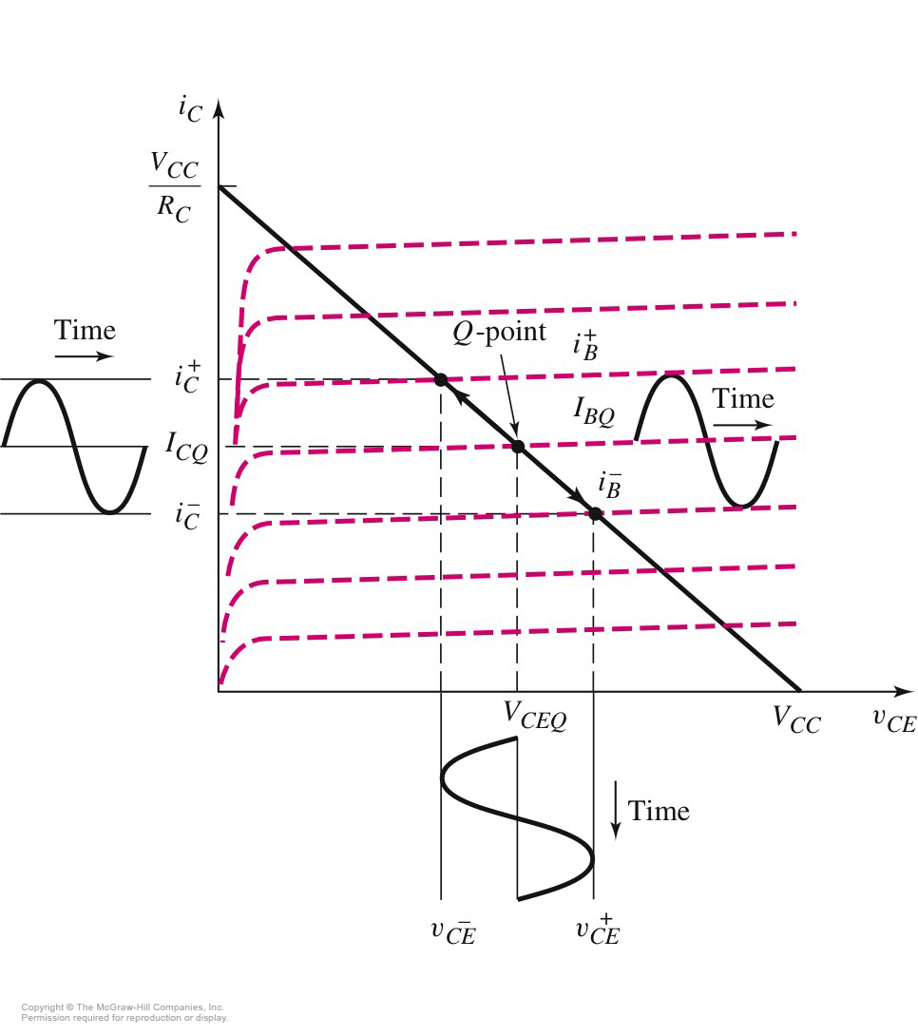
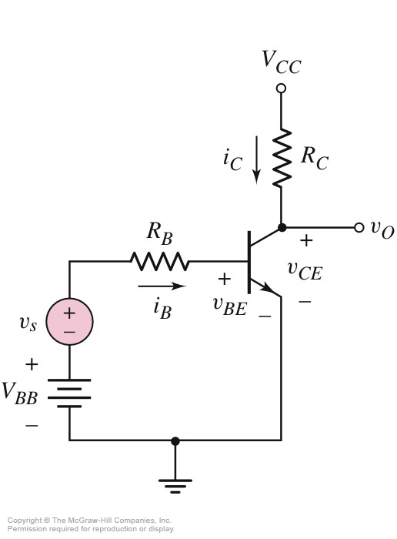
Common Emitter with Time-Varying Input

Slide 42
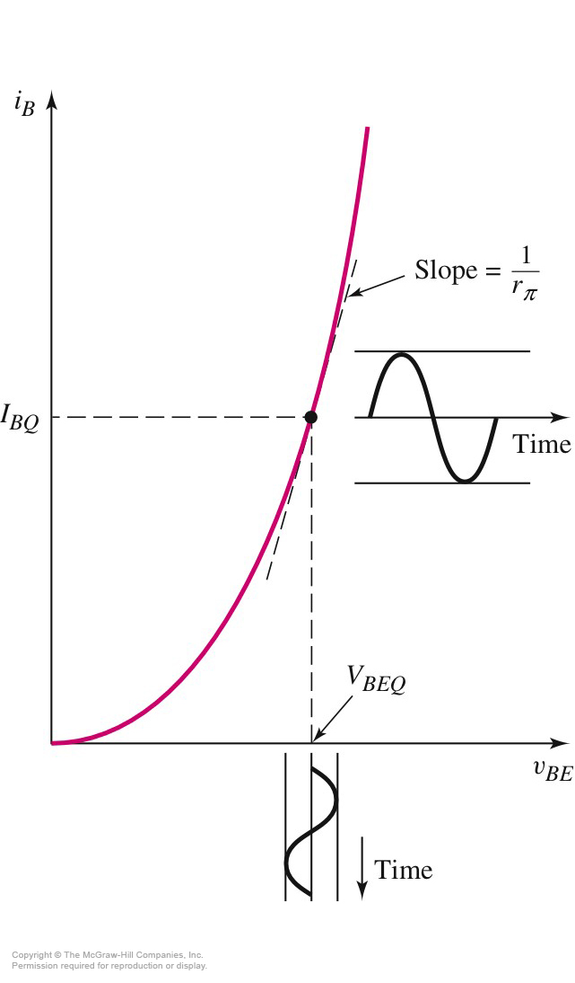
I_{B} versus V_{BE} Characteristic

Slide 43
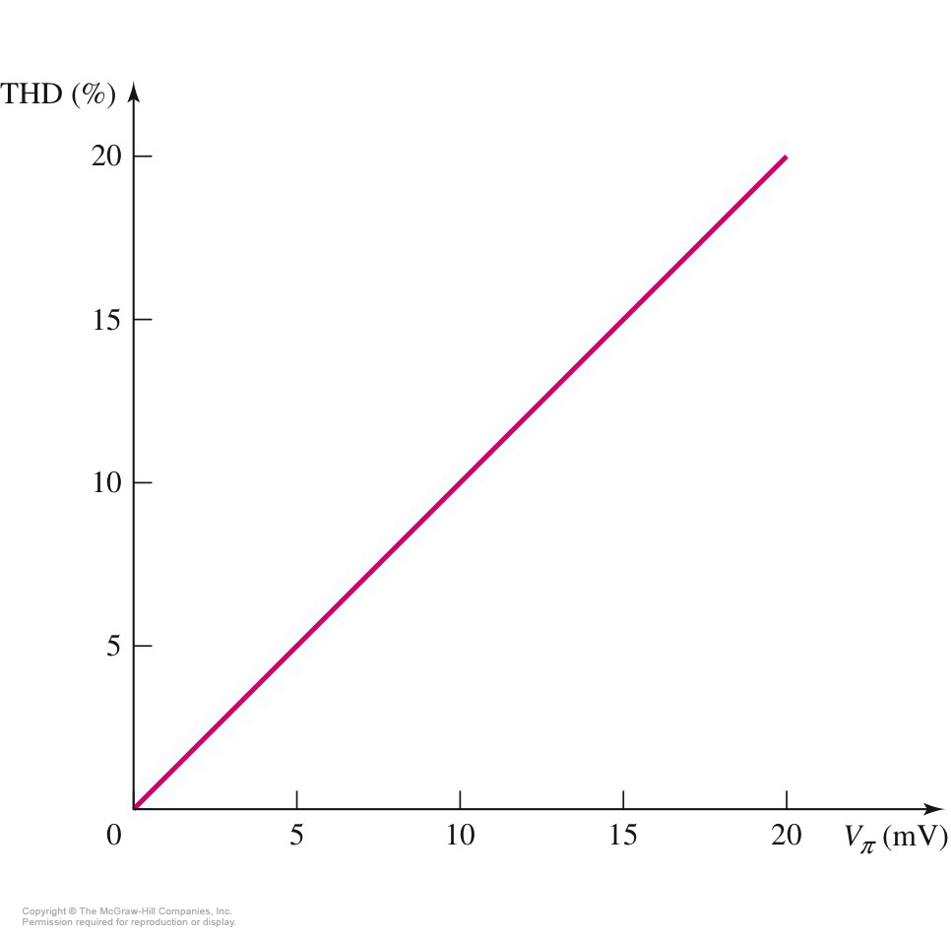
Total Harmonic Distortion (THD)

Slide 44
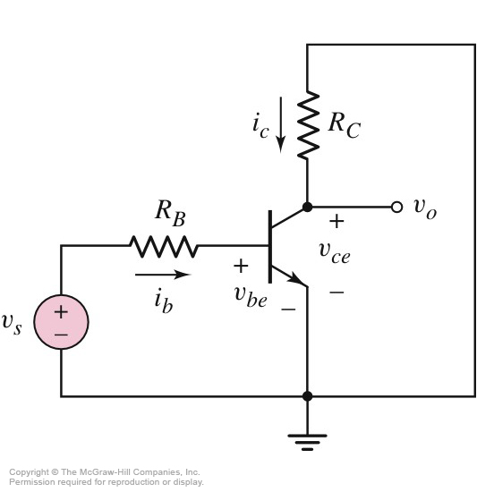
ac Equivalent Circuit for Common Emitter

Slide 45
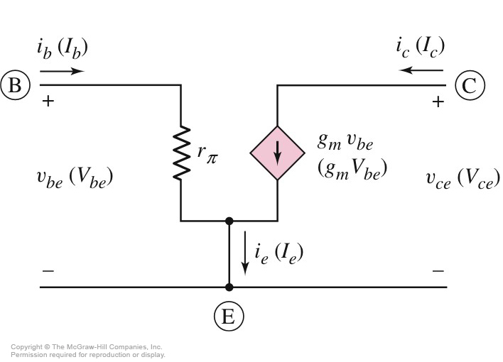
Small-Signal Hybrid π Model for npn BJT
Phasor signals are shown in parentheses.

Slide 46
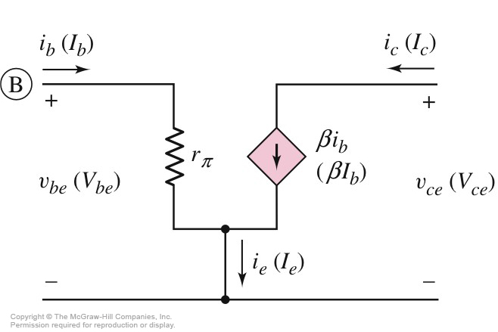
Small-Signal Equivalent Circuit Using Common-Emitter Current Gain

Slide 47
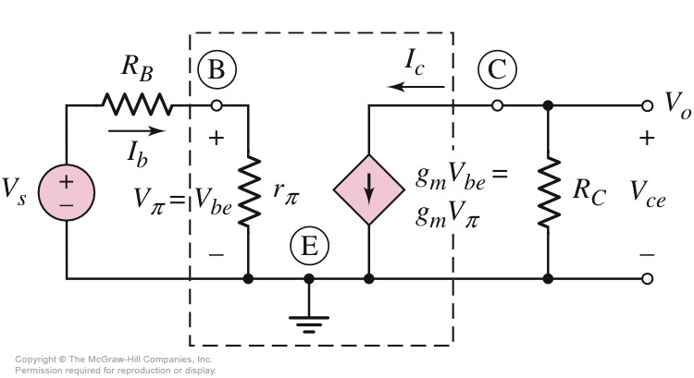
Small-Signal Equivalent Circuit for npn Common Emitter circuit-voltage gain

Slide 48
Problem-Solving Technique: BJT AC Analysis
Analyze circuit with only dc sources to find Q point.
Replace each element in circuit with small-signal model, including the hybrid π model for the transistor.
Analyze the small-signal equivalent circuit after setting dc source components to zero.

Slide 49
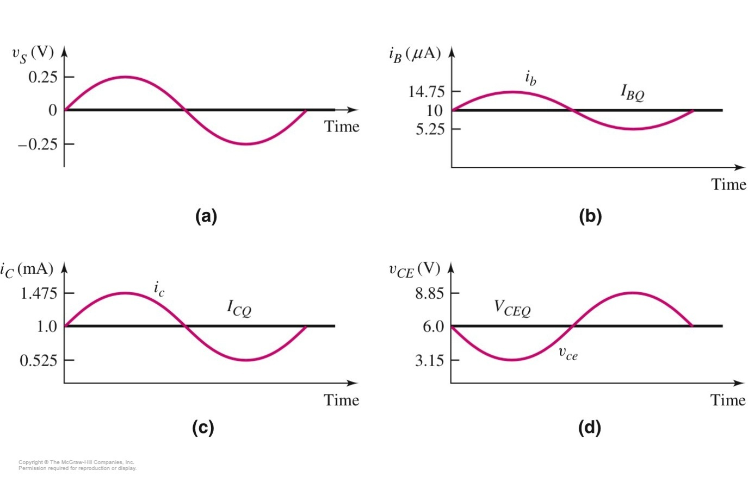
Calculate the small-signal voltage gain of the BJT as shown in figure. Assume the transistor and circuit parameters are β = 100, V_{CC} =12 V, V_{BE} = 0.7 V, R_{C} = 6 k Ω, R_{B} = 50 kΩ, and V_{BB} =1.2 V.

Slide 50
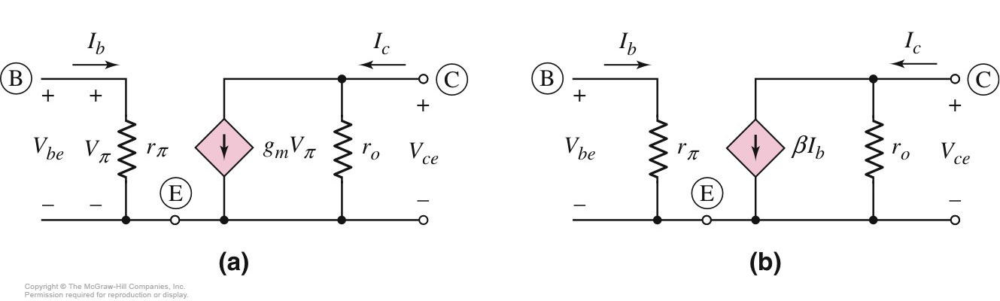
Hybrid π Model for npn with Early Effect

Slide 51
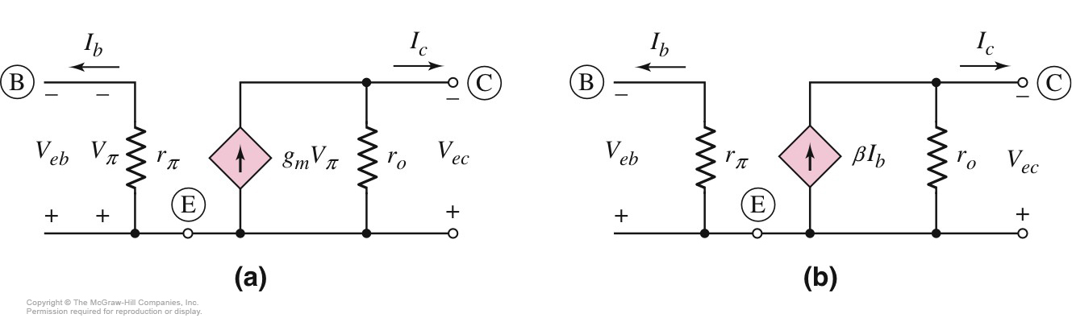
Hybrid π Model for pnp with Early Effect

Slide 52
BJT Amplifier configurations
Common emitter
Basic common emitter amplifier
With Emitter resistor
With bypass capacitor
Common collector (emitter follower)
Common base

Slide 53
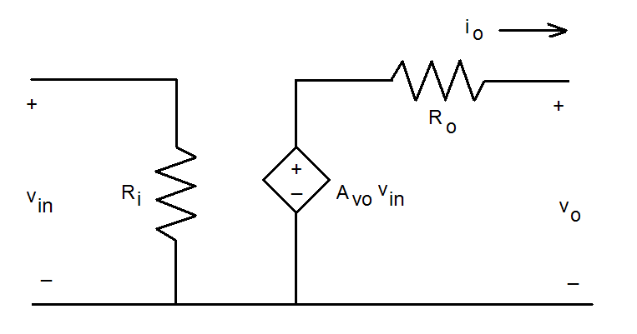
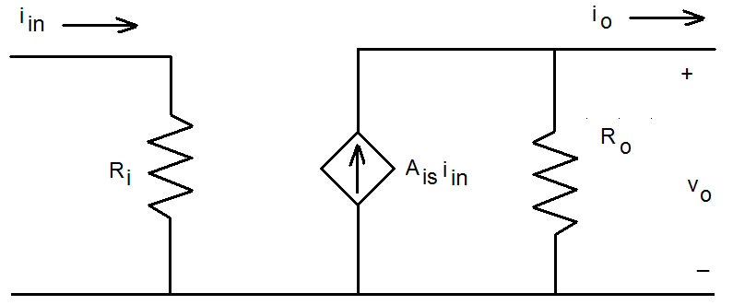
4 Equivalent 2-port Networks
Voltage Amplifier
Current Amplifier

Slide 54
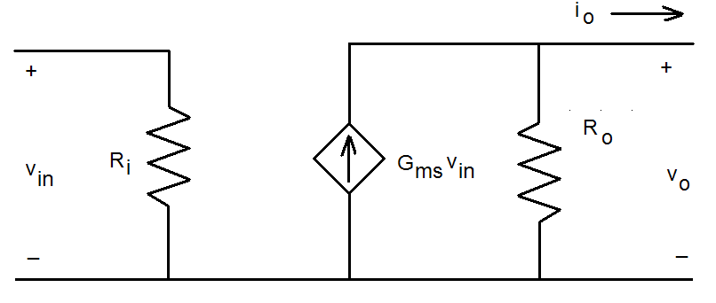
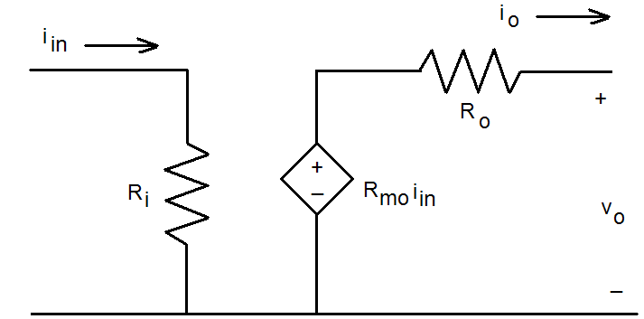
4 Equivalent 2-port Networks
Transconductance Amplifier
Transresistance Amplifier

Slide 55
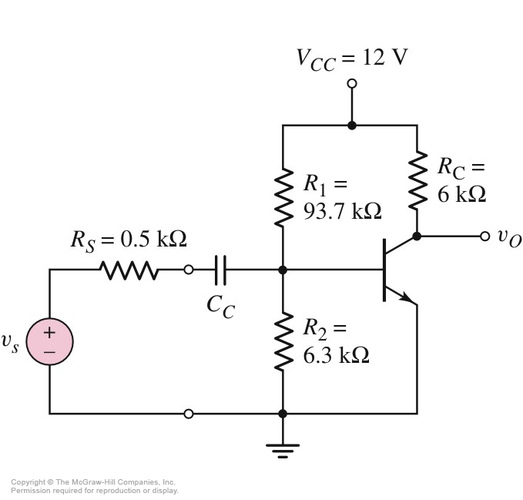
Common Emitter with Voltage-Divider Bias and a Coupling Capacitor

Slide 56
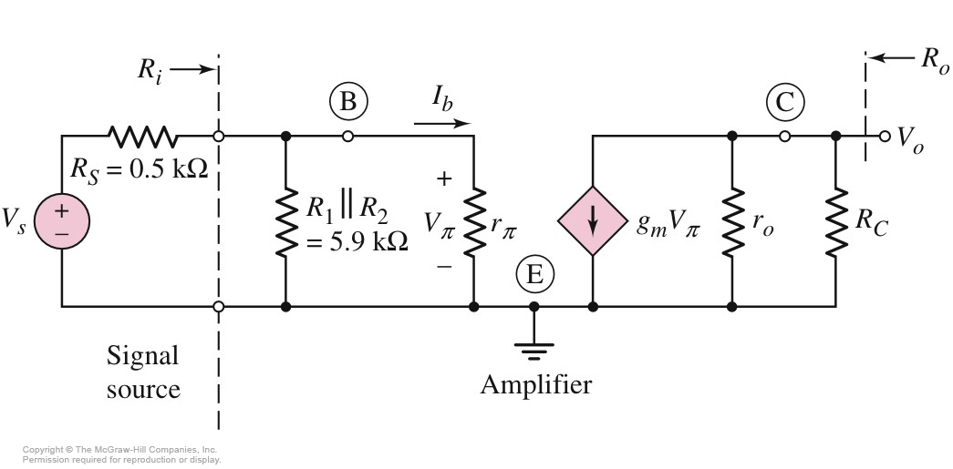
Small-Signal Equivalent Circuit – Coupling Capacitor Assumed a Short

Slide 57
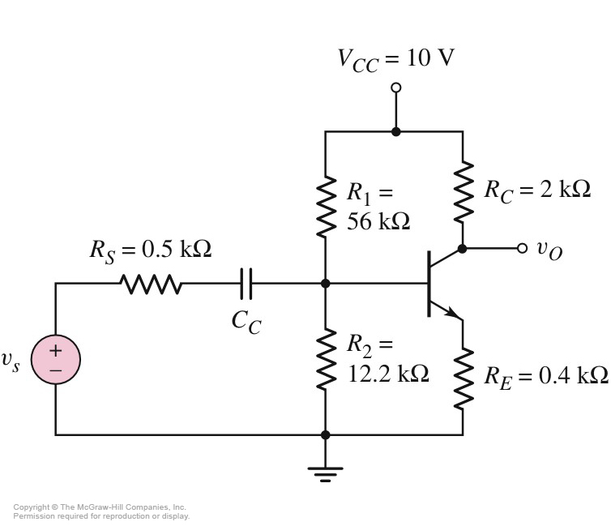
npn Common Emitter with Emitter Resistor

Slide 58
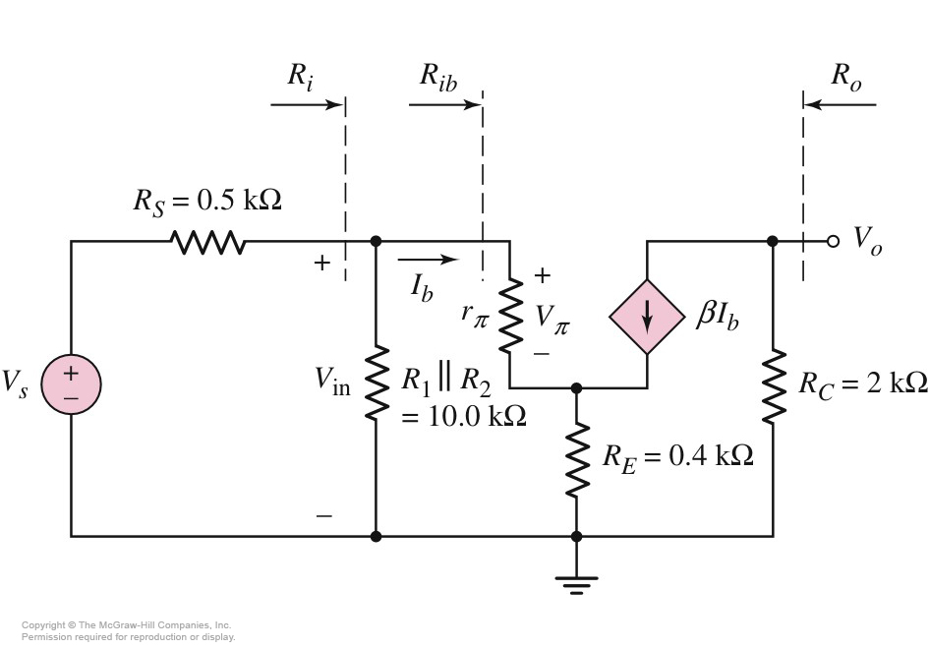
Small-Signal Equivalent Circuit: Common Emitter with R_{E}

Slide 59
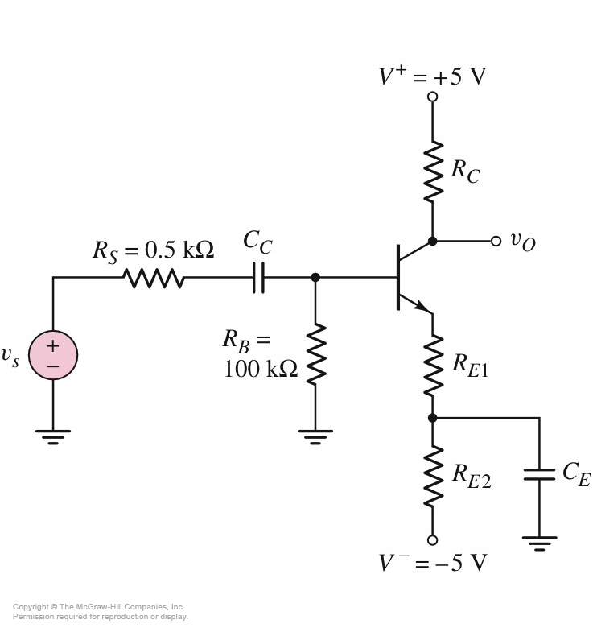
R_{E} and Emitter Bypass Capacitor

Slide 60
Field Effect Transistors (FET)
Metal-Oxide Semiconductor FET (MOSFET)
n-type MOS
p-type MOS
Junction FET (JFET)
pn junction FET

Slide 61
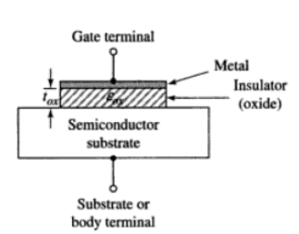
MOSFET
Smaller in size
High density VLSI
Based on field enhancement
Modulation of conductance of semiconductor substrate
Basic MOS capacitor structure

Slide 62


p-type
Understanding the field enhancement

Slide 63

n-type
p-type substrate: +ve gate voltage
n-type substrate: -ve gate voltage

Slide 64

n-channel enhancement mode MOSFET
Channel length, L ~ 1 μm
Oxide length, t_{ox} ~ 400 Angstrom
NMOS (carriers are electrons)
p-type substrate, two n-regions (n-source, n-drain)
Positive Gate voltage

Slide 65

Basic transistor operation
Cross-section after the
formation of electron inversion layer
Cross-section of n-channel MOSFET prior to formation of electron inversion layer

Slide 66

Threshold voltage V_{TN}: applied gate voltage required to create an inversion charge in which the density is equal to the concentration of majority carriers in semiconductor substrate.
voltage at which the device turns ON
Gate and drain voltages are measured with respect to source
V_{GS} < V_{TN,} No current
V_{GS} < V_{TN}, current flow (drain to source)

Slide 67

Thickness of inversion layer gives the relative charge density
V_{DS} increases, the voltage drop across the oxide near the drain terminal decreases
Decrease in induced charge density
Decrease in incremental conductance

Slide 68

V_{GS}-V_{DS}(sat)=V_{TN}
V_{DS}(sat)=V_{GS}-V_{TN}
V_{DS} increases to a point where the potential difference between gate and drain terminals (V_{GS}-V_{DS}) becomes equal to the threshold voltage
Induced charge density at drain terminal becomes zero
Incremental conductance subsequently zero

Slide 69

Family of curves
Ideal current-voltage characteristics

Slide 70

PMOS
n-type substrate, two p-regions (p-source, p-drain)
Gate voltage ???, carriers ??

Slide 71


Circuit symbols
NMOS
PMOS

Slide 72


Slide 73


NMOS Common-Source Circuit
Variable | Symbol meaning
i_{D},v_{GS} | Total instantaneous values
I_{D},V_{GS} | DC values
i_{d},v_{gs} | Instantaneous ac values
I_{d},V_{gs} | Phasor values

Slide 74
NMOS Transistor Small-Signal Parameters
Values depends on Q-point
Transconductance (relates output current to input voltage)
-can think as gain of a transistor

Slide 75

Simple NMOS Small-Signal Equivalent Circuit

Slide 76


NMOS Common-Source Circuit
AC
Small-signal

Slide 77
Problem-Solving Technique: MOSFET AC Analysis
Analyze circuit with only the dc sources to find quiescent solution. Transistor must be biased in saturation region for linear amplifier.
Replace elements with small-signal model.
Analyze small-signal equivalent circuit, setting dc sources to zero, to produce the circuit to the time-varying input signals only.

Slide 78
MOSFET Amplifier Configurations
Common gate
Common source
Common drain (source follower)
Input and output resistance characteristics are important in determining loading effects

Slide 79

Common-Source Configuration
DC analysis:
Coupling capacitor is assumed to be open.
AC analysis:
Coupling capacitor is assumed to be a short. DC voltage supply is set to zero volts.

Slide 80

Small-Signal Equivalent Circuit
Output resistance can be calculated by setting the independent input source V_{i} =0 i.e. V_{gs} =0.

Slide 81

DC Load Line
Q-point near the middle of the saturation region for maximum symmetrical output voltage swing,.
Small AC input signal for output response to be linear.

Slide 82
Example
Determine the small-signal voltage gain and input and output resistances of a common –source amplifier. For the circuit, the parameters are: V_{DD} =10 V, R₁=70.9 kΩ, R₂=29.1 kΩ, and R_{D}=5 kΩ. The transistor parameters are V_{TN} = 1.5 V, K_{n}=0.5 mA/V², and λ =0.01 V⁻¹. Assume R_{si}= 4 kΩ.

Slide 83

Common-Source Amplifier with Source Resistor
Source resistor is used to stabilize the Q-point against transistor parameter variation
- decreases the gain
Determine the small-signal voltage gain of a common-source circuit containing a source resistor. The transistor parameters are V_{TN} = 0.8 V, K_{n}= 1 mA/V², and λ =0.
A_{v} = -5.76

Slide 84

Small-Signal Equivalent Circuit for Common-Source with Source Resistor
Use of KVL from input around the gate-source loop
If g_{m} is very large,

Slide 85


Common-Source Amplifier with Bypass Capacitor
Small-signal equivalent circuit
To minimize the loss in small-signal voltage gain as in previous example, while maintaining the Q-point stability, a bypass capacitor can be added, or replacing the source resistor by a constant current source.

Slide 86
Determine the small-signal voltage gain of a common-source circuit biased with a constant current source and incorporating a source bypass capacitor. The transistor parameters are V_{TN} = 0.8 V, K_{n}= 1 mA/V², and λ =0.

Slide 87


Op-Amp
Amplifies the difference between two input signals to give an output signal
20-50 transistors
Ideal op-amp equivalent circuit

Slide 88
Op-Amp
Ideal
Inverting
T-network
Effect of finite gain
Summing amplifier
Non-inverting
voltage follower
Applications
current to voltage converter
voltage-to-current converter
difference amplifier
integrator & differentiator
precision half-wave rectifier

Slide 89

Small-Signal Equivalent Circuit: MOSFET with Input and Output Feedback

Slide 90

Equivalent Circuit of Op-Amp
Output voltage is limited: biased by dc voltages V⁺ and V⁻
v_{o} → V⁺, it will saturate or limited to a value nearly equal to V⁺, similar for V⁻.
V⁻ + ΔV <v_{o} <V⁺-ΔV

Slide 91


Inverting Op-Amp
Equivalent circuit

Slide 92

Inverting Op-Amp with T-Network

Slide 93

Inverting Op-Amp with Finite Differential-Mode Gain

Slide 94

= 3V
H(f) =j 2πf
X(t)
Y(t)
60 kΩ
Σ
500 Ω
+
v_{i}
~
v_{o}
-

